Slide 1

August 25th, 2026
Making Your Nonprofit’s Money Work Harder
A Two-Part Series on Reserves, Liquidity & Investment Strategy

Slide 2

Part 1
Liquidity and Operating Reserves for Nonprofit Organizations
Zachary Fowler, CPA
Manager, HBE LLP

Slide 3
Why Liquidity Matters
Liquidity is the ease with which an asset can be converted into cash
Nonprofits need liquid resources to:
  Support daily operations
  Maintain mission continuity
  Meet payroll
  Respond to emergencies
  Cover timing
Liquidity supports short-term financial needs, while long-term financial strength reflects an organization’s broader sustainability.
Notes:
A primary financial concern for any organization, but specifically nonprofits, is resource availability. Liquidity is the ease with which an asset can be converted into cash without significantly affecting its value. Why does liquidity matter? Nonprofits need sufficient liquid resources to help support daily operations. Can you meet payroll every two weeks. Can you pay vendor invoices on-time. Can you make sure that your program services are delivered without interruption. Making sure you have enough available liquid resources helps assure you can do all of these things. Managing your liquid resources correctly can help move your organization from the day to day operations to long-term financial strength and the ability to apply and grow your resources strategically.

Slide 4
Liquidity Basics
Option | Expected Return | Access
Operating checking | Low to no return | Immediate
Savings and money market accounts | Low to moderate return | Near-immediate
Insured cash sweep accounts | Moderate return | Same-day or next-day access; 100% FDIC insured
Certificates of deposit | Moderate to high return | Access at maturity
Each option involves tradeoffs among access, safety, yield, and administrative complexity.
Notes:
Cash is a nonprofits most common liquid resource. Operating or high interest checking accounts should be used for your daily operations such as payroll, bills, etc. These generally offer the lowest possible return, but offer immediate access to cash. Savings and Money Market accounts can be used for excess operating funds and provide a low to moderately returns while still offering immediate or near-immediate access to funds. Each of these should also be covered by FDIC insurance up to $250,000 per financial institution. Insured Cash Sweep (ICS) accounts have become more popular due to their ability to offer full FDIC insurance while only having to deal with one bank. Depending on the type of the account, cash balances are moved in/out automatically to help increase return, but maintaining enough funds in your operating account to cover current cash needs. This helps reduce the administrative burden of opening multiple accounts and different financial institutions. Interest rates are similar or slightly better than savings or money market accounts and cash is available the same day or next day. These accounts may require a higher minimum deposit. Certificates of deposit are used to manage longer-term liquidity needs, as funds are available at maturity. If taken before maturity a penalty is assessed. Generally offers moderate to high rates of return, but not near the fund availability. Deciding which account(s) are best for your nonprofit involves consideration of the tradeoffs between access, safety, return, and administrative complexity. As you organization accumulates excess operating funds, you can use a cash management ladder, starting with operating accounts, then moving to high-yield/insured sweep accounts, then government money markets, Treasury/CD ladder, then a long-term investment portfolio.

Slide 5
Accounting and Disclosure Context
Financial statement liquidity disclosures should include:
  Qualitative information
  Quantitative information
  Special borrowing arrangements, requirements imposed by resource providers to hold resources in separate accounts, and known liquidity problems
  Situations in which a nonprofit has not maintained sufficient cash and cash equivalents to comply with donor restrictions
  Other contractual resource constraints involving suppliers, creditors, loan covenants, and similar obligations
Notes:
ASC 958 requires that a not-for-profit entity shall disclose in the notes to the financial statements relevant information about the liquidity or maturity of assets and liabilities, including restrictions and self-imposed limits on the use of particular items, in addition to information provided on the face of the statement of financial position. This includes qualitative information that is useful in assessing an entity’s liquidity and communicates now a NFP manages its liquid resources available to meet cash needs for general expenditures within one year of the date of the statement of financial position. This also includes quantitative information. I.e. what assets are/are not available. Here is an example of what that footnote looks like. A nonprofit must also disclose:
Special borrowing arrangements, requirements imposed by resource providers to hold resources in separate accounts, and known liquidity problems
If a NFP has not maintained appropriate amounts of cash and cash equivalents to comply with donor-restrictions
Any other contractual resource constraints with suppliers, creditors, loan covenants, etc.

Slide 6
Example Footnote Disclosure
Liquidity | 2026
Cash and cash equivalents | $650,000
Accounts receivable | $200,000
Contributions receivable | $300,000
Investments | $600,000
Total financial assets | $1,750,000
Donor-restricted endowment funds | ($350,000)
TOTAL | $1,400,000
Notes:
Financial assets available for general expenditure, that is, without donor or other restrictions limiting their use, within one year of the statement of financial position date, comprise the following:
As part of the liquidity management plan, the Board has set up an operations reserve up to six months’ operating expense based on current year monthly expense averages. Cash reserves exceeding daily cash requirements are invested in short-term investments and CDs, and may be drawn upon in the event of financial distress or an immediate liquidity need resulting from events outside the typical life cycle of converting financial assets to cash or settling financial liabilities. In the event of an unanticipated liquidity need, the Organization also could draw upon $X of available line of credit.

Slide 7
What Are Operating Reserves?
Operating Reserves are unrestricted net assets that a nonprofit’s board has designated for stabilizing operations in times of financial stress.
  Board-designated
  NOT donor-restricted net assets
How they differ from other resources:
  Restricted funds: Subject to donor-imposed limitations on how they may be used
  Endowment funds: Cash and/or investments established by a nonprofit to provide long-term financial support
Notes:
What are operating reserves? Operating reserves are Unrestricted net assets that a nonprofit’s board has designated for stabilizing operations in times of financial stress. Operating reserves are designed to provide financial resilience, not simply investment return. Reserves can include cash, investments, or both. Operating reserves should not include donor-restricted assets, unless that is the restriction provided. Operating reserves also do not include endowment funds, whether they are board-designated or donor-restricted, but could include endowment earnings. Endowment funds are cash and/or investments established by a NFP designed to provide long-term financial support. Typically, the principal or original amounts are maintained while earnings are put to use, either in operations, program support, etc.

Slide 8
Why Operating Reserves Are Important
Cover delayed revenue.
  Federal funding interruptions
  Change from advance to reimbursement-based funding
Fund emergency expenses.
  Unexpected repairs/replacements of property and equipment
Sustain operations during downturns.
  Program service revenue decline or cut entirely
Bridge budget gaps.
Notes:
Why are operating reserves important? They can cover periods of delayed revenue such as the recent Federal funding interruptions or a switch from advance to reimbursement based grant funding. They can help fund emergency expenses such as unexpected repairs to or replacements of property and equipment or even help avoid costly short-term financing. They can help sustain operations during downturns and bridge budget gaps.

Slide 9
Why Operating Reserves Are Important
Support strategic pivots.
  Launch or exit a new program
  Expand or upgrade technology, capacity, or personnel
Strengthen donor, lender, and funder confidence.
  Donors and funders want to be associated with Organizations they can partner with into the future
  Lenders want assurance they will be paid back
Organizational morale
  Promotes confidence among staff and board during periods of instability
Notes:
They can support strategic pivots. Say your nonprofit identifies a new need within your community or program service opportunity. Or you have the opportunity to upgrade technology, capacity-building, or expand personnel. Operating reserves also help strengthen donor, funder, and lender confidence. Donors and funders want to be associated with those they can continue to partner with into the future and lenders want increased assurance they will be paid back. Finally, operating reserves can help organizational morale by promoting confidence among staff and board members during periods of financial instability.

Slide 10
Common Misconceptions
Misconception | The Reality
“Reserves are hoarding.” | Transparent communication can demonstrate that reserves are essential for mission continuity and special activities.
“All funds should be spent immediately on the mission.” | Reserves are a sustainability strategy, not a barrier to impact.
“Large reserves mean fundraising is unnecessary.” | Fundraising remains essential to nonprofit operations and cannot be replaced by reserves.
“Restricted funds can solve cash-flow problems.” | Restricted funds cannot be redirected without donor permission.
“Reserve policies are only for large nonprofits.” | When used strategically, reserve policies can benefit nonprofits of any size.
Notes:
Operating reserves can come with some common misconceptions. Reserves are hoarding. Donors or watchdogs may view large reserves as signs that a nonprofit doesn’t need support. In this case, be sure to communicate transparently, that reserves are essential to ensure mission continuity. All funds should be spent immediately on mission. Provide education on reserves as a sustainability strategy, not a barrier to impact. Large reserves means fundraising is unnecessary. Fundraising is essential to nonprofit operations and cannot be replaced by operating reserves. Operating reserves are designed to stabilize operations in times of financial distress, not provide a permanent replacement. Restricted funds can solve cash flow problems. Restricted funds must be used for a specific purpose or time period and cannot be redirected without donor permission. Reserve policies are only for large nonprofits. Reserve policies can help nonprofits of any size ensure mission continuity and eventually help the nonprofit on a path to long-term financial strength.

Slide 11
How Much Reserve Is Enough?
There is no universal target.
3–6 months
  A common benchmark based on adjusted operating expenses
When calculating adjusted operating expenses, consider excluding:
  Noncash expenses, such as depreciation or in-kind expenses
  Expenses associated with pass-through grants
  Expenses tied to restricted resources
  Expenses that would no longer occur during a disruption
Notes:
How much should a nonprofit include in its operating reserve. Its important to note that there is no universal reserve target for a nonprofit to use. A general baseline benchmark is 3-6 months of adjusted operating expenses. Adjusted operating expenses are total expenses less any noncash expenses such as depreciation or in-kind. You should also consider excluding expenses associated with pass-thru grants, expenses tied to restricted resources, or expenses that would disappear during a time of disruption.

Slide 12
Calculating Operating Reserve
Expenses by Natural Classification | 2026
Salaries and benefits | $3,000,000
Utilities | $125,000
Maintenance and repairs | $50,000
Supplies | $125,000
Insurance | $150,000
Professional services | $50,000
Depreciation | $100,000
In-kind | $150,000
TOTAL EXPENSES | $3,750,000
Target Operating Reserve | 2026
Total Expense | $3,750,000
Depreciation | ($100,000)
In-kind | ($150,000)
Adjusted Operating Expense | $3,500,000
Multiply by 6 months desired operating reserve | x 6
Divided by 12 months | /12
Target Operating Reserve | $1,750,000

Slide 13
How Much Reserve Is Available?
Formula:
unrestricted net assets
÷
annual operating expenses.
Remove any assets not available for reserve
Convert the result to months or days.
Notes:
Now you have your target, but how much do you have available?

Slide 14
Calculating Operating Reserve
Assets | 2026
Cash and cash equivalents | $650,000
Accounts receivable | $200,000
Contributions receivable | $300,000
Investments | $600,000
Prepaid expenses | $50,000
Property and equipment | $700,000
TOTAL | $2,500,000
Available Operating Reserve | 2026
Net assets without donor restrictions | $2,000,000
Prepaid expenses | ($50,000)
Property and equipment | ($700,000)
Net assets available for operating reserve | $1,250,000
Divide by adjusted operating expense | $3,500,000
Multiply by 12 months | x 12
Target Months in Reserve | 4.29
Net Assets | 2026
Without donor restrictions | $2,000,000
With donor restrictions | $350,000
TOTAL | $2,350,000

Slide 15
How Much Reserve Do We Need?
Consider starting low and building as you become more experienced with the plan and needs.
Adjust for revenue concentration, grant timing, payroll cycles, risk tolerance, and economic uncertainty.
Reasons for lower or higher reserves
Notes:
Consider starting on the low-end of your range and building as you become more experienced with the organizations’ operating reserve plan. Be sure to Adjust for revenue concentration, grant timing, payroll cycles, risk tolerance, and economic uncertainty. predictable revenue, diversified funding, strong liquidity, and access to reliable credit may support a lower target. significant dependence on one funder or revenue source, reimbursement-based government contracts, seasonal or volatile revenue, substantial payroll and fixed commitments, limited borrowing capacity, aging facilities, uncertain government funding, and difficulty reducing costs quickly might support a larger reserve.

Slide 16
Current Economic Environment
Inflation: 3.4% YTD 2026. Down from 7% in 2021 but up from 2.1% in 2016
Interest rates:
  How much does it cost you to obtain financing?
  How much can you earn on your money?
Labor costs:
  Employment Cost Index 3.3% through June 2026. Down from 5.5% in June 2022
Revenue uncertainty:
  Lost funding; seeking replacement funding
Delayed payments or reimbursement cycles.
Scenario planning: best, moderate, and worst case.
Notes:
Incorporating the current economic environment into your operating reserve decision is an important consideration, but not an end all. Inflation, interest rates, labor and general costs, revenue uncertainty, and delayed payment or reimbursement cycles are just a handful of items to take into account. Consider building in a best, moderate, or worst case scenario to your operating reserve calculation.

Slide 17
Using Reserves Strategically
Operating reserves can support:
  Emergency stabilization
  Periods of financial volatility
  Technology and infrastructure
  Staff investments
  Program launches or exits
  Strategic capacity building
Operating reserves should not be used to cover:
  Recurring timing differences
  Ongoing deficit programs
Notes:
Using reserves strategically. A lot of this is a review, but its important to note that an operating reserve should not be used to cover recurring timing differences or fluctuations or ongoing deficit programs. These situations should be addressed with proper planning or budget process.

Slide 18
Building and Replenishing Reserves
Reserves may be built or replenished through:
  Annual budget allocations
    Set aside funding at the beginning of the year
  Year-end surplus allocations
    Allocate funds until the reserve target is reached
    Allocate a specific percentage of the annual surplus
  Other funding sources
    Cost savings
    Investment income
    One-time unrestricted gifts
    Campaign or event allocations
    Targeted foundation investments
Notes:
How to we build and replenish reserves once we know our target. You can use an annual budget allocation which provides upfront funding. You could allocate any year-end surplus from operations, whether that’s an allocation up to your target or if you decide to allocate a set percentage of the surplus. Utilize cost savings from certain programs or areas. Allocate a portion or all investment income. One-time unrestricted gifts. Campaign or event allocations, Targeted foundation investment if you have an association foundation.

Slide 19
Governance and Policy
Start with a board-approved reserve policy that establishes:
  A clear purpose
    Define the objectives of the reserve
  A target reserve level
    Determine what is appropriate for your nonprofit
    Consider what your organization can reasonably set aside today
    Establish an acceptable target range
  Permitted uses
    Identify specific uses while allowing flexibility for unforeseen circumstances
    Prevent reserves from being used for regular, recurring periods of fluctuation
  Approval requirements
    Identify who has authority to approve the use of reserves
Notes:
The board is responsible for setting and approving an operating reserve policy and management is responsible for executing that policy. All policies should have a purpose and define a target reserve level or range. A policy should also define the permitted uses. Be sure to include specifics, but leave open the possibility of unforeseen circumstances. A policy should define any approval requirements to use the reserve as well as an investment approach.

Slide 20
Governance and Policy
Investment approach
  What instruments are permissible
  Maximum and Minimum liquidity requirements
  FDIC coverage expectations
Replenishment plan
  Key to sustainability
  One or a combination of the methods mentioned previously
Measurement frequency and policy review
  Measure at least annually
  Review the policy every 2-3 years
Notes:
An investment approach should include permissible instruments, minimum and maximum liquidity requirements, and FDIC coverage expectations. If your target reserve is 4 months, consider holding 2 months in same or next-day instruments with the rest in instruments with longer maturities. A policy should define a replenishment plan in the case that operating reserves are utilized and could be one or a combination of methods mentioned on the previous slide. A policy should define the measurement frequency of the reserve, which should at be at least annually. Be sure to review the policy every 2-3 years or whenever you review your other organizational policies.

Slide 21
Reserves and External Funding
How lenders may view low reserves
  Insufficient operating funds
  A potential inability to meet near-term obligations
How grantors may view reserve levels
  Low reserves: The organization may be unable to sustain programs or meet near-term obligations
  High reserves: The organization may appear to be seeking funds to increase investment balances rather than address a genuine need
Clear communication matters.
  Position reserves as capital that protects the mission
  Be transparent with donors and nonprofit watchdogs
Notes:
Operating reserves are important considerations for external funders. Lenders could view low or no operating reserves as a risk of insufficient operating funds or an inability to meet near-term obligations. The same is true for grantors or donors. They might be worried your nonprofit won’t be able to sustain programs. The opposite can be true at the same time. A grantor or donor could view high operating reserves as concern their funding won’t go to a genuine need and will just add to the existing excess funds on hand. That is why it is key to emphasize that operating reserves are mission protection capital and to be transparent about the purpose of the operating reserves.

Slide 22
From Operating Reserves to Quasi-Endowments
When reserves exceed near-term operating needs, an organization may consider a quasi-endowment.
What is a quasi-endowment?
  A quasi-endowment is a board-designated fund that functions like an endowment but remains legally unrestricted. The board retains the authority to spend or remove the principal at any time.
  A quasi-endowment is:
    Board-designated, not donor-restricted
    More flexible than a permanent endowment
    A potential source of long-term financial stability
    A demonstration of the nonprofit’s long-term commitment
    A possible starting point for an endowment campaign
Notes:
When reserves exceed near-term operating needs, an nonprofit can start to think about long-term financial stability and strength by establishing a quasi-endowment. A quasi-endowment is a board-designated fund that functions like an endowment but remains legally unrestricted, meaning the board can spend or remove the principal at any time. Its important to note that these are Board-designated, not donor-restricted. This provides greater flexibility than a traditional permanent endowment, which are donor-restricted and generally must maintain the original gift. Board-designated endowments can still have a defined purpose such as capital projects, programs expansion, or to cover contingencies, but offer the ability to be re-directed with a board resolution. Permanent endowments can be beneficial to an organization, but they have to be a fit as well. Permanent endowments that are a good fit can provide long-term financial security and benefits, while those that aren’t a good fit can be like hand-cuffs to an organization. Having unrestricted funding allows the NFP to be strategic in the deployment of those funds and the flexibility to evolve as needed to serve its stakeholders. Consider a gift-acceptance policy to help decide if a donor gift is right for your NFP. You have the right to refuse. A quasi-endowment plays a role in long-term sustainability by demonstrating a commitment by the nonprofit as well as serve as a stepping stone towards a larger investment plan or to help launch an endowment or capital campaign.

Slide 23
Closing Message
Liquidity protects daily operations. Operating reserves protect mission continuity. Quasi-endowments and prudent investing can help financially stronger nonprofits convert excess reserves into long-term strategic capacity.

Slide 24
Questions?

Slide 25

Part 2
Christopher Bedient,
CFA, CFP®
Partner, HBE Wealth Management, LLC
Creating an Investment Strategy That Supports Your Mission

Slide 26
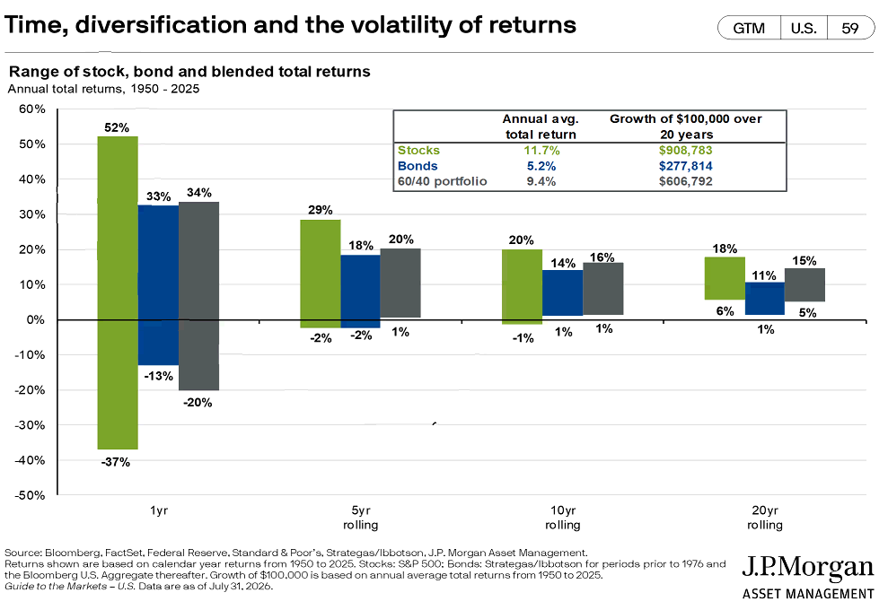
IPS: Time Horizon And Risk Tolerance

Slide 27
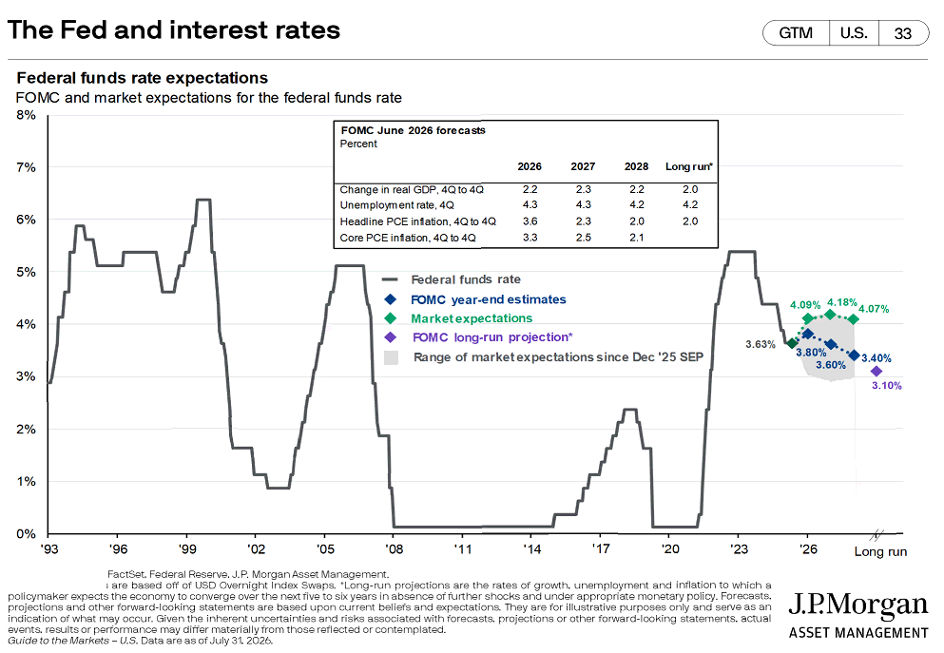
Spending Policy / Liquidity Requirements

Slide 28
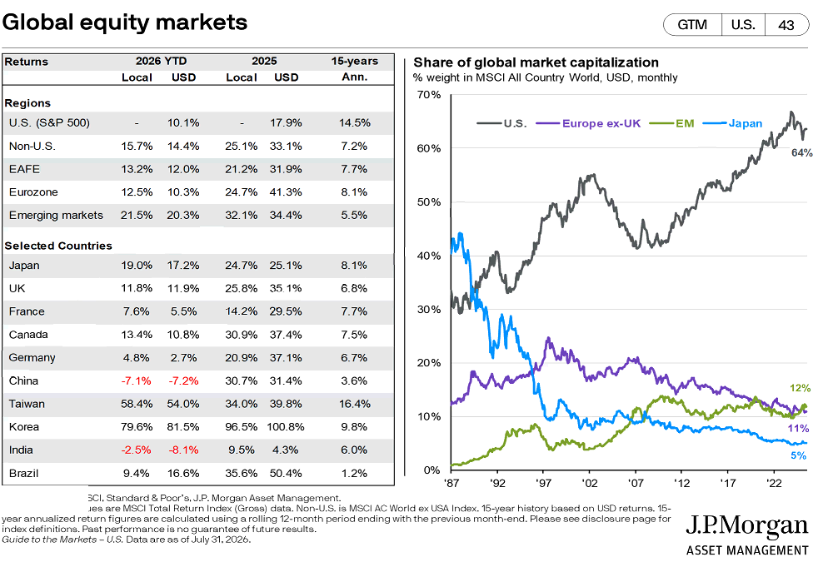
Strategic Asset Allocation

Slide 29
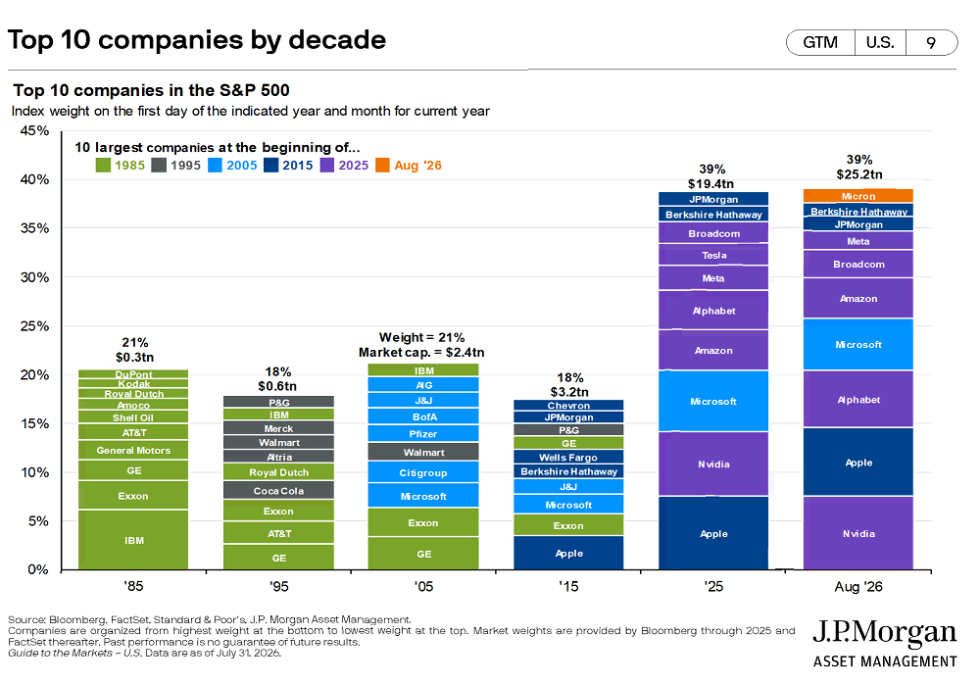
Diversification And Concentration Limits

Slide 30
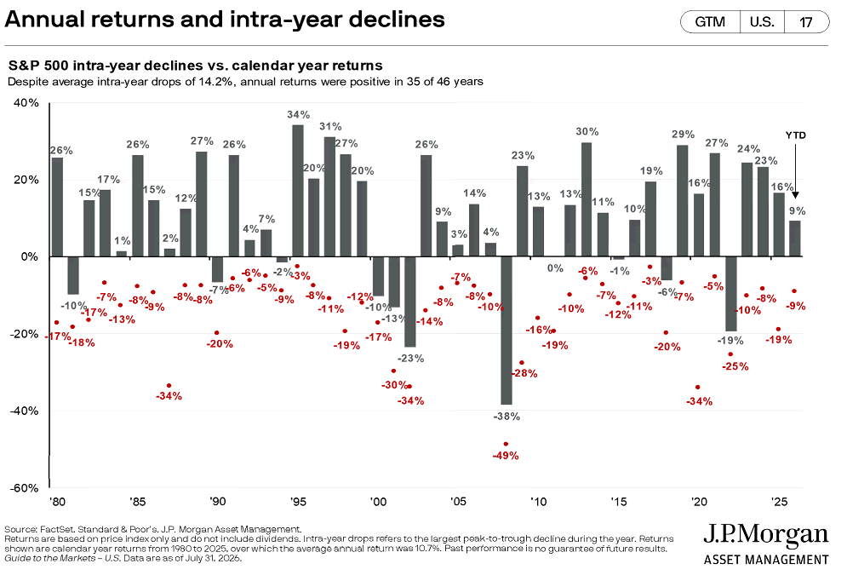
Rebalancing

Slide 31
Review Process
  Conduct an interim review when there are significant changes to:
    Spending
    Liquidity needs
    Organizational finances
    Donor restrictions
    Investment strategy
    Applicable laws
  Each review should also include:
    An evaluation of fees and expenses
    Performance measurement

Slide 32
Questions?

Slide 33
Contact Us
Zachary Fowler, CPA
Manager, HBE LLP
Email: zfowler@hbecpa.com
Office: 402.423.3232
Christopher Bedient,CFA, CFP®
Partner, HBE Wealth Management, LLC
Email: cbedient@hbecpa.com
Office: 402.423.3232

