Slide 1
July 11th, 2024 Grant Funding: What are my responsibilities as a grant awardee?
Hosted by
Tanner A. Weir, CPA
Senior Accountant, HBE

Slide 2
Guest Speakers
MEG BLUE
Director of Community Investments,
United Way of the Midlands
VICTORIA GRASSO
President,
Cooper Foundation
LUCAS J. POST, CPA
Senior Accountant,
HBE LLP

Slide 3
Federal Grant Regulations
Uniform Guidance
2 CFR Part 200
Both are extremely technical
Useful if you know where to look
Other sources may be more useful for grantees

Slide 4
Sam.gov
Entities must be registered
Apply for federal grants or bid on government contracts
Compliance requirement look-up
Funding information

Slide 5
Grant Agreements
Best source of specific requirements
Pass through organization
Subrecipient vs. contractor

Slide 6
Single Audit
$750,000 expended in a fiscal year set to increase to $1,000,000 for fiscal year ends September 30, 2025, or later
Audit driven by the Compliance Supplement
Entity’s compliance and internal controls over compliance will be tested thoroughly

Slide 7
Compliance Supplement
New version released each year by the Office of Management and Budget
Mostly used by auditors
Excellent source of information for programs specifically listed
Part 6 is the hidden gem of Federal grant compliance

Slide 8
Part 6 Compliance Supplement
Internal control background
Examples
List is not all-inclusive

Slide 9
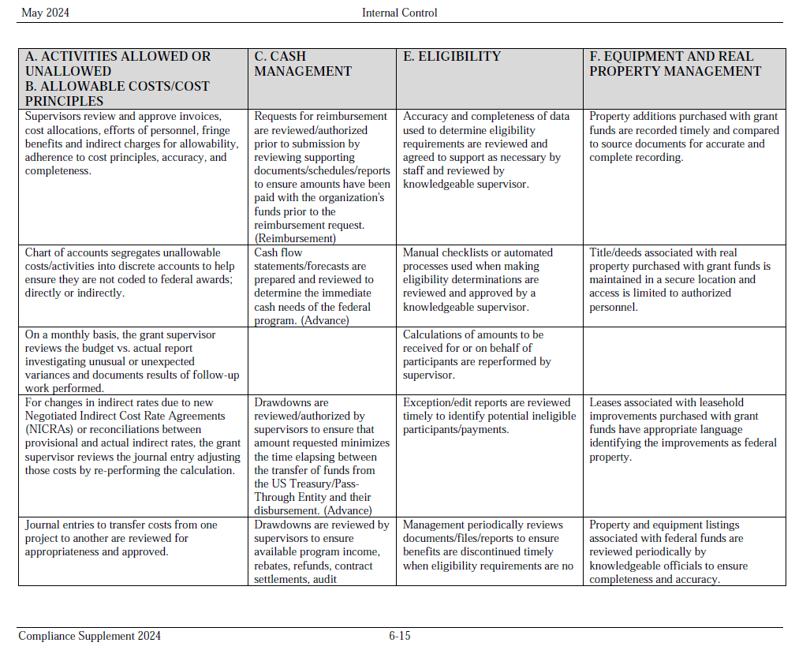

Slide 10
Common Risks and Findings
Internal Controls
Subrecipient monitoring
Subrecipient vs. contractor
Procurement
Allocation

Slide 11
Final Thoughts
Rules and regulations are constantly changing
HBE is available for any questions or consulting about staying in compliance

Slide 12
Questions?

Slide 13
Contact Information
www.hbecpa.com
Meg Blue
United Way of the Midlands
mblue@uwmidlands.org
Victoria Grasso
Cooper Foundation
victoria.grasso@cooperfoundation.org
Lucas J. Post, CPA
HBE LLP
lpost@hbecpa.com
Tanner A. Weir, CPA
HBE LLP
tweir@hbecpa.com
Disclaimer: These materials do not constitute tax or legal advice, and cannot be relied upon for purposes of avoiding penalties under Internal Revenue Code. These materials may omit discussion of exceptions, qualifications, definitions, effective dates, jurisdictional differences, and other relevant authorities and considerations. In no event should an audience member rely on these materials in planning a specific transaction or litigation. Non-lawyers should not attempt to provide legal services or legal advice in circumstances where that would violate laws against unauthorized practice of law. HBE will not be responsible for any error, omission, or inaccuracy in these materials.
Notes:
Thank you for your time today. My contact information is listed on this slide. If you have any questions regarding this program, please feel free to reach out to me or any other team members from HBE.

