Slide 1
December 12, 2023 Prepare for Success in 2024 with Year-End Tax Planning
Jackson T. Love, CPA | Senior Accountant

Slide 2
Topics Covered
2023 & 2024 Tax Brackets
Planning Considerations for Individuals
Planning Considerations for Businesses

Slide 3
2023 & 2024 Tax Brackets
2023 Tax Brackets for Single Filers, Married Couples Filing Jointly, and Heads of Households
Rate | For Unmarried Individuals | For Married Individuals Filing Joint Returns | For Heads of Households
10% | $0 to $11,000 | $0 to $22,000 | $0 to $15,700
12% | $11,000 to $44,725 | $22,000 to $89,450 | $15,700 to $59,850
22% | $44,725 to $95,375 | $89,450 to $190,750 | $59,850 to $95,350
24% | $95,375 to $182,100 | $190,750 to $364,200 | $95,350 to $182,100
32% | $182,100 to $231,250 | $364,200 to $462,500 | $182,100 to $231,250
35% | $231,250 to $578,125 | $462,500 to $693,750 | $231,250 to $578,100
37% | $578,125 or more | $693,750 or more | $578,100 or more
Source: Internal Revenue Service. Tables from https://taxfoundation.org/2023-tax-brackets
2024 Tax Brackets for Single Filers, Married Couples Filing Jointly, and Heads of Households
Rate | For Unmarried Individuals | For Married Individuals Filing Joint Returns | For Heads of Households
10% | $0 to $11,600 | $0 to $23,200 | $0 to $16,550
12% | $11,600 to $47,150 | $23,200 to $94,300 | $16,550 to $63,100
22% | $47,150 to $100,525 | $94,300 to $201,500 | $63,100 to $100,500
24% | $100,525 to $191,950 | $201,050 to $383,900 | $100,500 to $191,950
32% | $191,950 to $243,725 | $383,900 to $487,450 | $191,950 to $243,700
35% | $243,725 to $609,350 | $487,450 to $731,200 | $243,700 to $609,350
37% | $609,350 or more | $731,200 or more | $609,350 or more
Source: Internal Revenue Service. Tables from https://taxfoundation.org/2024-tax-brackets

Slide 4
Planning Considerations for Individuals
Inflation Reduction Act Considerations
Revisions to the Electric Vehicle Tax Credit (Non-Refundable)
Many new provisions effective for 2023
Namely, cars must be assembled in the US to qualify for the credit
$7,500 off sticker price at Dealership
Energy Credits (Non-Refundable)
Enhanced energy credits for energy-efficient home improvements
Things like windows, doors, insulations, heating/cooling systems, water heaters, etc
Qualifying property placed in service in 2023 through 2033
Out with the old $500 lifetime credit and in with $1,200 annual credit

Slide 5
Planning Considerations for Individuals
Itemized Deductions
SALT Cap
State and Local tax deduction remains capped at $10,000, which can limit the ability of many taxpayers to itemize
Maximizing Itemized Deductions – Charitable Contributions
Harder to itemize with current standard deduction amounts
Best options relate to charitable contributions
Options include:
Bunching charitable contributions every two to five years to itemize that year
Making larger contributions to a Donor Advised Fund
Non-Itemized Option – QCD from IRA
Up to $100,000 per year, a great option for individuals over 70 ½

Slide 6
Planning Considerations for Individuals
Things to Consider for 2023/2024
Tax Rates & Tax Brackets
Tax rates continue to be at historically low rates due to the Tax Cuts & Jobs Act
Brackets are also relatively wide and are getting wider due to inflation adjustments
Possible to consider recognizing income now rather than deferring, depending on amounts and timelines
Annual Exclusion for Gifts is up to $17,000 from $16,000
Possible Changes on the Horizon
Preferential tax rates and brackets, along with QBI deduction, are set to end after 2025, depending on action Congress takes
Could make it worthwhile to accelerate income prior to then – depending on economic considerations

Slide 7
Planning Considerations for Individuals
1099-K Reporting
What is a 1099-K?
Report of payments you received for goods or services during the year from Third Party Settlement Organizations (TPSOs)
Old Reporting Requirement
$20,000+ and 200+ Transactions
New Reporting Requirement
$600+
2023 will follow old Reporting Requirement
2024 will ease into New Reporting Requirement - $5,000+

Slide 8
Planning Considerations for Businesses
Accounting Method Changes
Worth reviewing with your accounting professional, depending on your situation, if there are method changes that make sense
Examples Include:
Changing from accrual to cash or cash to accrual basis
Optimizing inventory valuation methods and how inventory is tracked
Catching up on previously missed depreciation

Slide 9
Planning Considerations for Businesses
Depreciation Considerations
Bonus Depreciation is now down to 80% for many assets in 2023, and is set to go down again to 60% in 2024
Lower by 20% each year until 2027.
Meals & Entertainment
All entertainment is non-deductible, since the TCJA
Meals have returned to 50% deductible for 2023 and 2024.
Company parties for employees remain 100% deductible

Slide 10
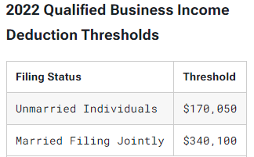
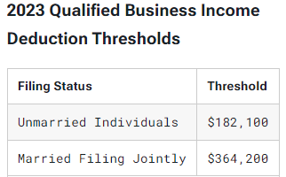
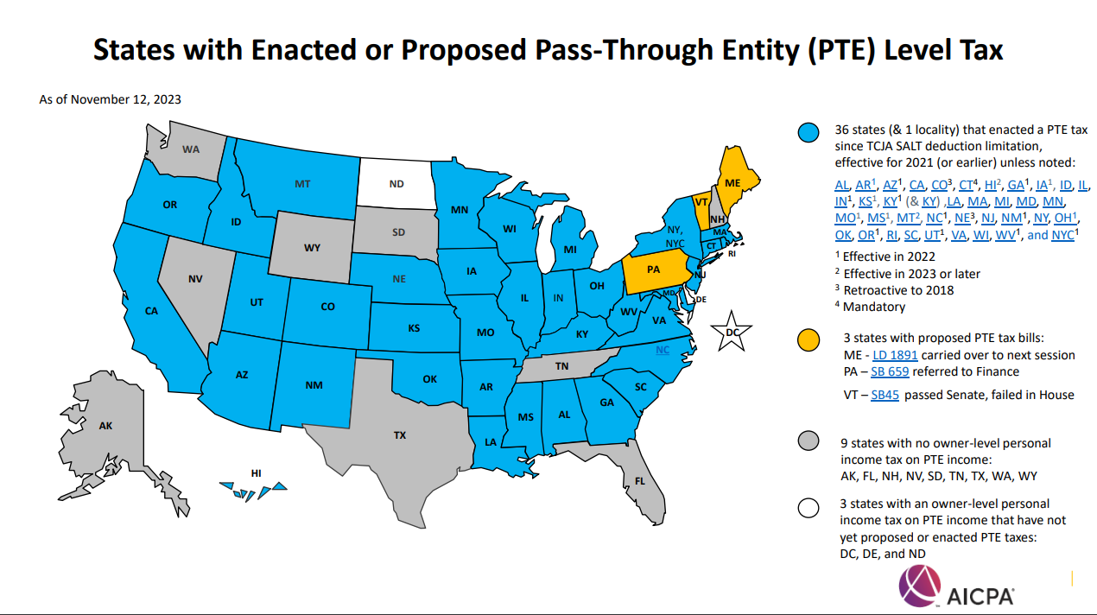
Planning Considerations for Businesses
Partnership/S Corporation Considerations
Continue to maximize 20% QBI deduction
State Pass-Through Entity Tax Elections
A way to deduct state taxes at the business rather than the individual level, which gets around the $10,000 SALT cap for itemized deductions
Nebraska recently enacted a Pass-Through Entity Tax Election

Slide 11
Year-End Tax Guides
Watch for HBE’s year-end Tax Guides, covering these topics and more, to come out soon via email.
As always, please reach out to your advisor at HBE with any questions about opportunities that may apply to your particular tax situation.

Slide 12
Contact Information
www.hbecpa.com
Jackson T. Love, CPA
Senior Accountant
jlove@hbecpa.com
402.895.5050
Disclaimer: These materials do not constitute tax or legal advice, and cannot be relied upon for purposes of avoiding penalties under Internal Revenue Code. These materials may omit discussion of exceptions, qualifications, definitions, effective dates, jurisdictional differences, and other relevant authorities and considerations. In no event should an audience member rely on these materials in planning a specific transaction or litigation. Non-lawyers should not attempt to provide legal services or legal advice in circumstances where that would violate laws against unauthorized practice of law. HBE will not be responsible for any error, omission, or inaccuracy in these materials.

