Slide 1
LEGAL DOCUMENTS & MORE
By Catherine N. Swiniarski, J.D.

Slide 2
ELDER LAW OF OMAHA Catherine N. Swiniarski
Graduated from Creighton University School of Law in 1986
Member of the Nebraska & Iowa Bar Associations
Member of the Elder Counsel
Accredited Veterans Benefits Planner

Slide 3
WHAT DOES AN ELDER LAW ATTORNEY DO?
Estate planning so wishes are carried out while a client is alive and after they pass away
Medicaid Qualification strategies
Planning strategies to obtain VA Benefits
Asset protection strategies to protect and extend assets for lifetime of client and spouse
Medicaid and VA Benefits Application assistance
Drafting of necessary Trusts
Advocate for our senior clients

Slide 4
Financial Power of Attorney
What is a Financial Power of Attorney (FPOA)?
A simple and reliable way to arrange for someone to manage their finances if they become incapacitated.
Who should have a FPOA?
All adults (18 and older) should have a FPOA. Spouses and parents are not automatically given power of attorney rights. An agent must be appointed in a legally binding FPOA.
When does it take effect?
Durable: A financial power of attorney can be drafted so that it goes into effect as soon as the client signs it.

Slide 5
Healthcare Power of Attorney
What is a Healthcare Power of Attorney (HPOA)?
A legal document that allows an individual to empower another with decisions regarding his or her healthcare and medical treatment.
When does the agent have the right to make health care decisions on the principal's behalf?
When principal requests assistance.
The appointed person may make health care decisions on the first person’s behalf if that person’s attending physician certifies in writing that he or she is incompetent.

Slide 6
WHAT TO LOOK FOR IN A VALID POWER OF ATTORNEY
Recent Significant changes have occurred in the law since January 2013. Financial Powers of Attorney should have been updated since then.
Legible and not written-on by the client
Signed and dated
Notarized
A copy is a as good as an original.

Slide 7
ADVANCE DIRECTIVES / LIVING WILLS
“Living Will” and “Advance Directive” are both terms for the same document.
Usually provides specific directives about the course of treatment that is to be followed by health care providers and caregivers.
May forbid the use of various kinds of burdensome medical treatment.
May also be used to express wishes about the use or foregoing of food and water, if supplied via tubes or other medical devices.
Document used only if the individual has become unable to give informed consent or refusal due to incapacity.
Can be very specific or very general.

Slide 8
LAST WILL AND TESTAMENT
What are the requirements of a last will and testament?
Name of an executor
Payment of any debts
Any charitable donations
Bequests to beneficiaries
List of the powers of the executor
Typed or printed
Signed by the maker or testator
Signed by witnesses who can attest to the validity of the document
State that the testator revokes any previous wills or amendments to such previous wills

Slide 9
WHEN SHOULD A DOCUMENT BE UPDATED OR REVIEWED?
Remember the Four D’s
Death Divorce
Diagnosis Decade

Slide 10
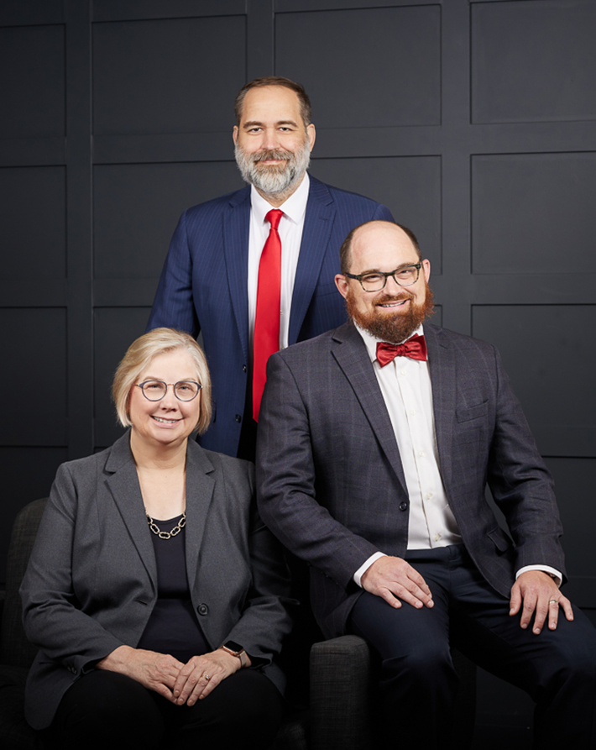
CATHERINE N. SWINIARSKI
Attorney-at-Law
LICENSED IN NEBRASKA & IOWA
NICK HALBUR
Attorney-at-Law
LICENSED IN NEBRASKA & IOWA
CAMERON KROEGER
Attorney-at-Law
LICENSED IN NEBRASKA
CATHERINE@ELDERLAWOMAHA.COM
www.ElderLawOmaha.com

